Slide 1
MongoDB – Intro & CRUD

Slide 2
SQL vs NoSQL
Goal: Store Data and Make it Easily Accessible
Use a Database!
Quicker Access than with a File
SQL Databases
NoSQL Databases
e.g. MySQL
e.g. MongoDB

Slide 3
What’s SQL?
User
Id | Email | Name
1 | josh@miu.edu | Josh Edward
2 | emma@miu.edu | Emma Smith
3 | … | …
Order
Id | user_id | product_id
1 | 1 | 2
2 | 1 | 1
3 | 2 | 2
Product
Id | Title | Price | Description
1 | Node.js | 10 | Good
2 | Angular | 20 | Great
3 | React.js | 20 | Great

Slide 4
Core SQL Database Characteristics
Data Schema
All Data (in a Table) has to fit!
id
name
age
Data Relations
Tables are connected
One-to-One
One-to-Many
Many-to-Many

Slide 5
SQL Queries
SELECT * FROM users WHERE age > 28
SQL Keywords / Syntax
Parameters / Data

Slide 6
NoSQL
Database
Shop
Collections
Users
Orders
Documents
{ name: 'Josh', age: 18 }
{ … }
{ name: ' Emma' }
{ … }
Schemaless!

Slide 7
NoSQL Characteristics
NO Data Schema
No Structure required!
{ name, id, age }
{ id, age }
NO Data Relations
No / Few Connections
You CAN relate documents but you don‘t have to (and you shouldn‘t do it too much or your queries become slow)

Slide 8
Horizontal vs Vertical Scaling
Horizontal Scaling
Vertical Scaling
Add More Servers (and merge Data into one Database)
Improve Server Capacity / Hardware

Slide 9
SQL vs NoSQL
SQL
NoSQL
Data uses Schemas
Schema-less
Relations!
No (or very few) Relations
Data is distributed across multiple tables
Data is typically merged / nested in a few collections
Horizontal scaling is difficult / impossible; Vertical scaling is possible
Both horizontal and vertical scaling is possible
Limitations for lots of (thousands) read & write queries per second
Great performance for mass read & write requests

Slide 10
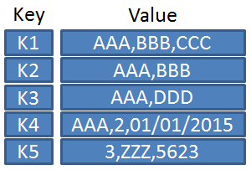
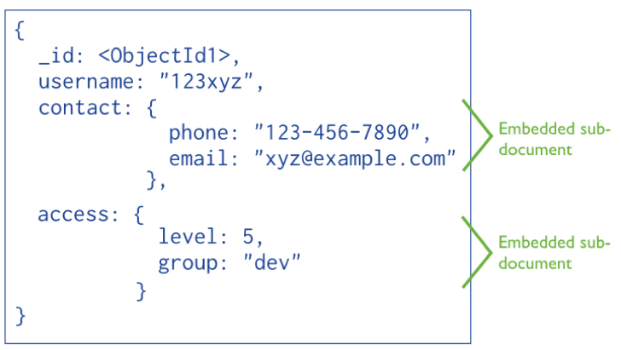
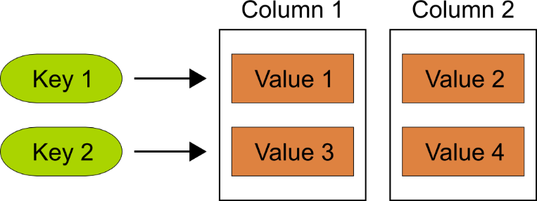
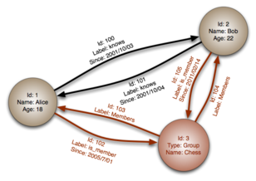
NOSQL Database Types
Document Databases
Column Family Stores
Key-Value Stores
Key-Value pairs in hash table, always unique key. Logical group of keys are called: buckets
Document Databases uses Key-Value pairs in a document (JSON, BSON)
Column Stores data is stored in cells that are grouped in columns of data rather than rows (unlimited columns)
Graph Databases, uses flexible graphical representation (edges and nodes) instead of k/v pairs. Index free. Very fast for associative data sets and maps.
Graph Databases

Slide 11
NoSQL Revolution
NoSQL (originally referring to "non SQL" or "non relational") databases were created for "Big Data" and Real-Time Web Applications, it provides new data architectures that can handle the ever-growing velocity and volume of data.
Name | Year | Type | Developer
MongoDB | 2008 | Document | 10Gen
CouchDB | 2005 | Document | Apache
Cassandra | 2008 | Column Store | Apache
CouchBase | 2011 | Document | Couchbase
Riak | 2009 | Key-Value | Basho Technologies
SimpleDB | 2007 | Document | Amazon
BigTable | 2015 | Column Store | Google
Azure Cosmos DB | 2017 | Multi-Model | Microsoft

Slide 12

What is MongoDB?
MongoDB is an open-source document database that provides high performance, high availability, and automatic scaling.
Non relational DB, stores BSON documents.
Schemaless: Two documents don't have the same schema.

Slide 13
Document Data Model
A record in MongoDB is a Document
Structure of key/value pairs
Values may contain other documents, arrays and arrays of documents.
{
_id: 1,
firstname: "Josh",
lastname: "Edward",
email: "test@mim.edu",
phones: ["6414511111", "6414512222"]
}

Slide 14
BSON
BSON, short for Binary JSON, is a binary-encoded serialization of JSON-like documents.
Both JSON and BSON sup­port Rich Documents (embedding documents and arrays with­in other documents and arrays).
BSON also contains extensions that allow representation of data types that are not part of the JSON spec. (For ex­ample, BSON has a BinData ObjectId, 64 bits Integers and Date type…etc)
Notes:
https://www.mongodb.com/json-and-bson

Slide 15
BSON characteristics
Lightweight
Keeping spatial overhead to a minimum is important for any data representation format, especially when used over the network.
Traversable
BSON is designed to be traversed easily. This is a vital property in its role as the primary data representation for MongoDB.
Efficient
Encoding data to BSON and decoding from BSON can be performed very quickly in most languages. For example, integers are stored as 32 (or 64) bit integers and they don't need to be parsed to and from text.

Slide 16
Non-Relational
Scalability and Performance (embedded data models reduces I/O activity on database system)
Depth of Functionality (Aggregation framework, Text Search, Geospatial Queries)
To retains scalability
MongoDB does not support Joins between two collections ($loopup)
No relational algebra: tables/columns/rows (SQL)
No Transactions across multiple collections (Do it programmatically, documents can be accessed atomically)

Slide 17
Schema
By default, a collection does not require its documents to have the same schema, the documents in a single collection do not need to have the same set of fields and the data type for a field can differ across documents within a collection.
Starting of MongoDB 3.2, you can enforce document validation rules for a collection during update and insert operations

Slide 18
Document Structure
The value of a field can be any of the BSON data types, including other documents, arrays, and arrays of documents.
const doc = {
_id: new ObjectID('5e44ab7638d4f738f05c57a8'),
name: { first: "Josh", last: "Edward" },
birth: new Date('Oct 31, 1979'),
email: "test@mim.edu",
phones: ["6414511111", "6414512222"]
}

Slide 19
Setup
Follow the link to install MongoDB
https://docs.mongodb.com/manual/tutorial/install-mongodb-on-windows/
Two ways to start your MongoDB
as a Windows Service
From the Services console, locate the MongoDB service.
Right-click on the MongoDB service and click Stop (or Pause).
from the Command Interpreter
Create database directory - C:/data/db
Start your MongoDB database.
"C:\Program Files\MongoDB\Server\4.2\bin\mongod.exe" --dbpath="c:\data\db"
Connect to MongoDB
"C:\Program Files\MongoDB\Server\4.2\bin\mongo.exe"

Slide 20
Collections
MongoDB stores documents in collections. (Collections are similar to tables in relational databases)
use myDB
If a database/collection does not exist, MongoDB creates the db/collection when you first store data for that collection
use myNewDB
db.myNewCollection.insert( { x: 1 } )
The insert() operation creates both the database myNewDB and the collection myNewCollection if they do not already exist.

Slide 21
Shell Demo
show dbs
use testDB // switch or create
show collections
db.testCol.insert({"name": "Josh"})// db var refers to the current database
db.testCol.find() // notice _id
// passing a parameter to find a document that has a property "name" and value "Josh"
db.testCol.find({"name":"Josh"})
// save() = upsert if _id provided
db.testCol.save({"name":"Mike"})
// insert 10 documents – Shell is C++ app that uses V8
for (var i=0; i<10; i++){ db.testCol.insert({"x": i}) }

Slide 22
Shell Demo
db.testCol.save({a:1, b:2})
db.testCol.save({a:3, b:4, fruit: ["apple", "orange"] })
db.testCol.save({name: "Josh", address: {city: "Fairfield",
zip: 52557,
street: "1000 N 4th street"} })
// show documents in a nice way, it will only work when you have nested or larger documents:
db.testCol.find().pretty()

Slide 23
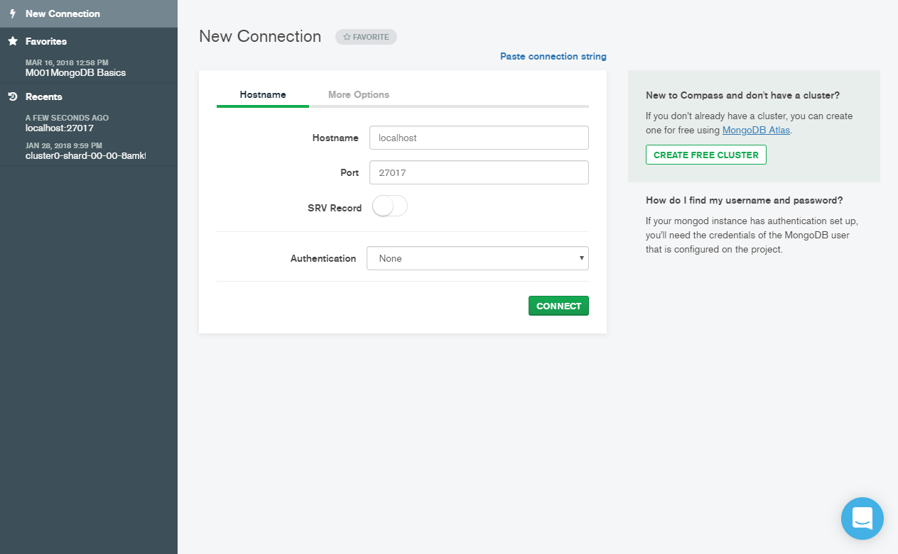
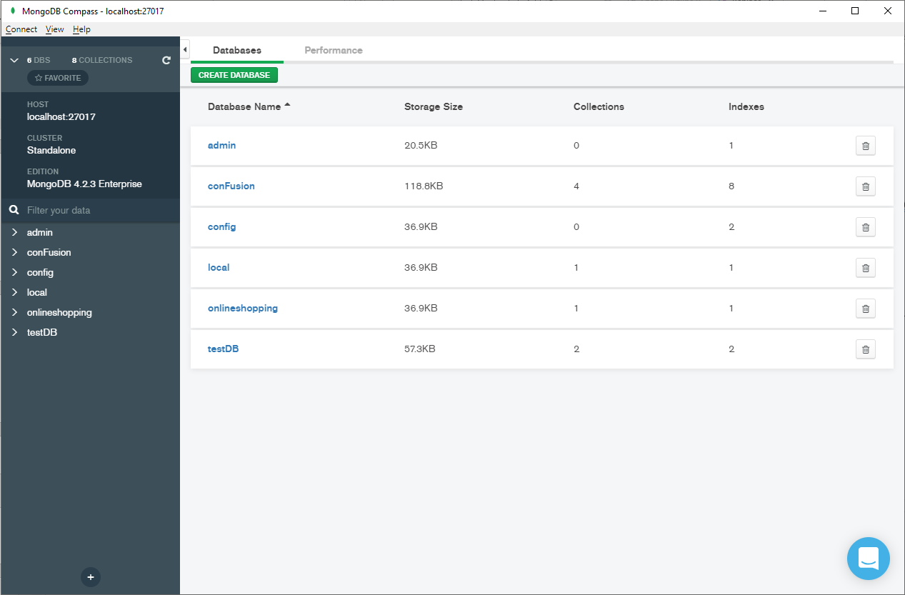
MongoDB Compass
As the GUI for MongoDB, MongoDB Compass allows you to make smarter decisions about document structure, querying, indexing, document validation, and more. Commercial subscriptions include technical support for MongoDB Compass.

Slide 24
General Rules
Field names are strings.
The field name _id is reserved for use as a primary key. It is immutable and always the first field in the document. It may contain values of any BSON data type, other than an array.
The field names cannot start with the dollar sign ($) character and cannot contain the dot (.) character or null. Field names cannot be duplicated.
The maximum BSON document size is 16 megabytes. (To store documents larger than the maximum size, MongoDB provides the GridFS API)

Slide 25
Resources
Mongo Shell: https://docs.mongodb.com/manual/mongo/
MongoDB CRUD Operations: https://docs.mongodb.com/manual/crud/

Slide 26
Homework
Update online shopping application, change CRUD operations on Product Model to use MongoDB.
Admin: save/edit/delete product, view all products
Shop: view detail of product, view all products

